Slide 1
Lock in Tool
Metro Slovakia

Slide 2
Background & Purpose:
Aim is to increase the profitability from customers. In order to do that the sales force needs to know what is the Overall Total Income Percentage(OTI%) that they get from the customer; they are working with.

Slide 3
Technologies used:
Frontend: HTML, CSS, JavaScript
Backend: PHP
Database: SQL (Microsoft SQL Server)

Slide 4
Modules:
Login (IDAM)
Home - Customers
Forcasted OTI
NNNBP

Slide 5
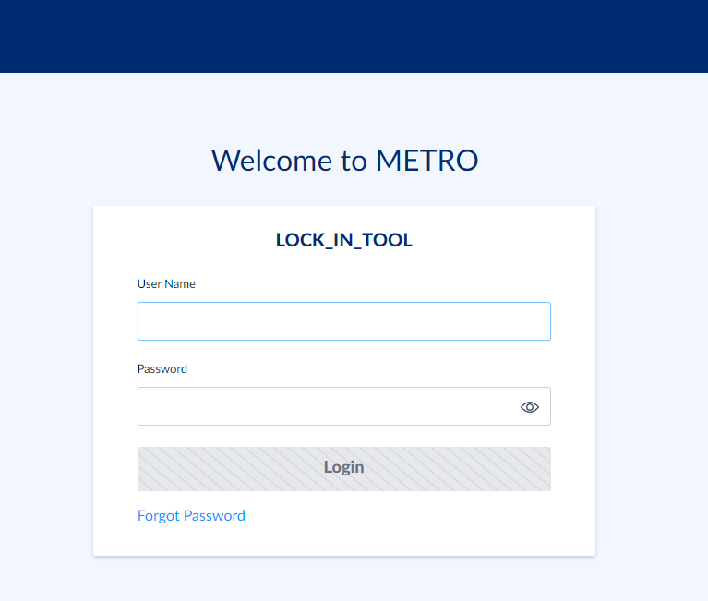
Login
User can login via IDAM Login Credentials

Slide 6
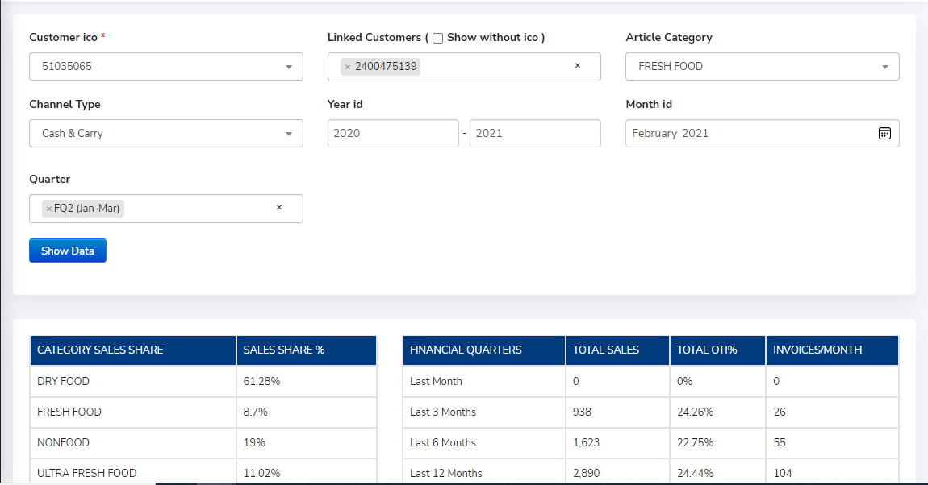
Customer
Users can select the data to transfer to the offer list
INPUTS :
Customer HO number linked customer numbers Article Category Channel type Month and year Range Quarter OUTPUT :
Data Summary

Slide 7
OTI Calculations/Offer List
Here all the calculations are done as per user’s input selection
INPUTS :
Article’s Colli and Requested Price Bonus Types, Amount, Percentage OUTPUT :
Backbonus Calculations Farcasted OTI%

Slide 8
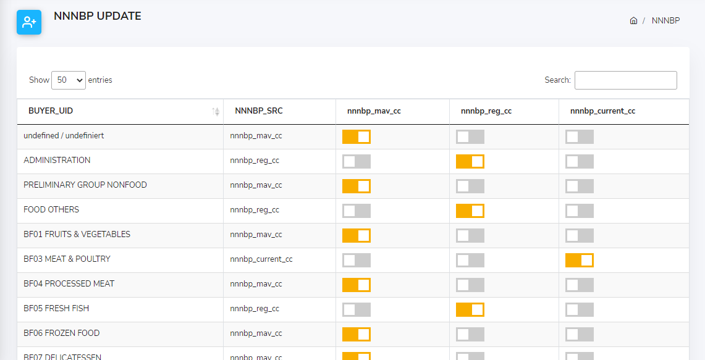
NNNBP
User can select Price Sources from this module

Slide 9
THANK YOU

